Slide 1
Integrating machine learning and decision analysis W. Alton Russell, PhD Assistant Professor McGill School of Population and Global Health
EPIB 676-2, McGill University, 22 March 2023

Slide 2
Agenda
Improving ML risk prediction through a decision science lens
Improving decision analyses with ML
Tailoring policies to manage iron deficiency in blood donors
Targeting overdose prevention for prescription opioid patients
Other research plans

Slide 3
Case study: Targeted follow-up to prevent chronic kidney disease after inpatient acute kidney injury
Background
At Lucile Packard Children’s Hospital, about 25% of ICU patients and 5% of floor patients experience acute kidney injury (AKI) during hospitalization
Some AKI survivors go on to develop chronic kidney disease (CKD)
Insufficient capacity to follow up with all AKI survivors
Objective
Predict risk of chronic kidney disease (CKD) 3-12 months after a hospitalization
Enroll highest-risk patients in new AKI survivors’ clinic for follow-up renal care
Notes:
We can’t follow up with ALL AKI survivors, but if we knew who were at greatest risk then we could follow up with SOME

Slide 4
Case study prediction task
(1) Predict:
(2) Enroll: The highest-risk patients will be enrolled in a new AKI survivors’ clinic
Inpatient stay
3 – 12 months after discharge
AKI develops
CKD stage 3+ may or may not develop
At discharge, which AKI survivors will develop CKD in the next 3-12 months?
AKI = acute kidney injury; CKD = chronic kidney disease

Slide 5
Developing clinical risk prediction with supervised learning
Features
Train & validate: Learn a function mapping features to outcomes
Predicted Outcome
Labeled Outcome
Minimize difference
Features
Test: Make sure the model performs well on unseen data
Predicted Outcome
Labeled Outcome
Verify they’re close
Features
Implement: Use the model on unlabeled data to inform clinical decisions
Predicted Outcome
Inform Decision
Notes:
The basic procedure for developing an ML prediction algorithm is well known and widely accepted.
There are numerous excellent free online courses and bootcamps
Looking at disparity between # of published prediction models and # of models that have been implemented in clinical settings, it’s clear that mastering this process is not sufficient for successful implementation

Slide 6


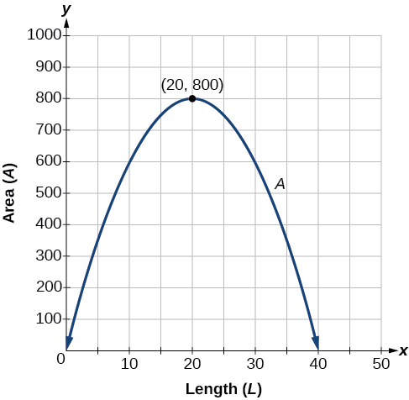
Zooming out
Features
Prediction
How do we evaluate the potential value of the prediction model?
Decision
Clinical workflow
Outcome
Decision
How does the prediction model fit into the clinical workflow?
Features
Prediction
How do we design for maximal utility (rather than just predictive ability)?
Notes:
Zooming out, 3 questions that the train/validate/test procedure does not address

Slide 7

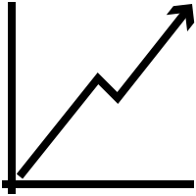
Keys to successful implementation
Assess potential value
Design for the workflow
Maximize utility, not accuracy

Slide 8
A model can add value when
Actionable intervention – intervening can change the outcome
Intervention creates value – intervening will improve health and/or save money
Expected value exceeds costs
Outcome would have happened
+ -
+
-
TP
FP
Predicted outcome would happen
Can calculate how good the model must be to add value
FN
TN
Notes:
If the patient really would experience an adverse event without intervention, correctly predicting that can have enormous value, and failing to intervene can have grave consequences
If we intervene on a patient who was never going to experience the adverse outcome, this is wasteful but often not too harmful
Correctly identifying a patient who will not experience the outcome is usually neutral or positve

Slide 9
Assessing value of CKD prediction model
Actionable intervention – enroll in AKI survivor’s clinic
Intervention adds value – Preliminary evidence of good outcomes from other centers
Expected value exceeds cost
Outcome would have happened
+ -
Benefit of true positive >> harms of false positive or false negative
Even modest predictive ability might add value
+
-
CKD managed or prevented
1-3 unnecessary outpatient visits
Predicted outcome would happen
CKD not prevented or detected early
No issues

Slide 10
Engagement with clinicians and domain experts is key to assessing potential value!
Notes:
Nephrologist Scott Sutherland and Blood safety expert Brian Custer were essential to success of respective project.
Domain experts have knowledge needed to assess potential value
Walking through the process of assigning value to TP, FP, and so on, either rigorously or informally, is a valuable exercise

Slide 11
Keys to successful implementation
Assess potential value
Design for the workflow
Maximize utility, not accuracy

Slide 12
Designing for clinical workflow: When to run model?
Too early
Not enough data to make good prediction
Available data accumulating
Clinical workflow
Outcome
Opportunity to intervene shrinking
Too late
More costly, more difficult, or too late to modify outcome
‘Sweet spot’
Good features available
Outcome modifiable
Notes:
It’s possible that no sweet spot exists for your use case. Better to find out earlier.
Again, working with clinicians and domain experts is critical!

Slide 13
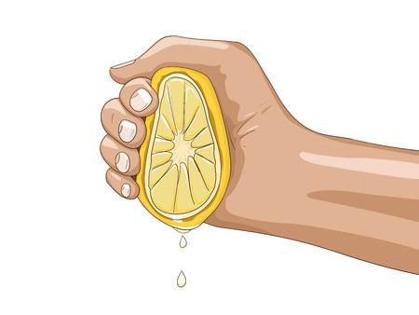
What features to use?
Available data accumulating
Clinical workflow
Outcome
Opportunity to intervene shrinking
‘Sweet spot’
Use features available for most patients at ‘sweet spot’
Be wary of collecting data just for your model
Increase cost of model
Barrier to implementation
Juice might not be worth the squeeze!

Slide 14
CKD prediction model
Available data accumulating
Inpatient stay
CKD?
Opportunity to intervene shrinking
Discharge
Predict at discharge
All inpatient data available, patient easily contacted for clinic enrollment
Serum creatinine only lab value used
Other labs not routinely collected for most patients

Slide 15
Keys to successful implementation
Assess potential value
Design for the workflow
Maximize utility, not accuracy

Slide 16
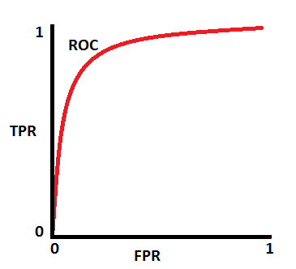
The decision threshold should maximize utility
Risk prediction scores often need to be converted into binary decisions
If risk > threshold, intervene
Typical ways to set threshold
Default to 0.5
Maximize measure of predictive ability (accuracy, F1 score, etc)
Threshold should be set in a way that maximizes utility
TP | FP
FN | TN
TP | FP
FN | TN
TP | FP
FN | TN
Points on ROC = possible decision thresholds
TP | FP
FN | TN
What threshold maximizes utility?

Slide 17
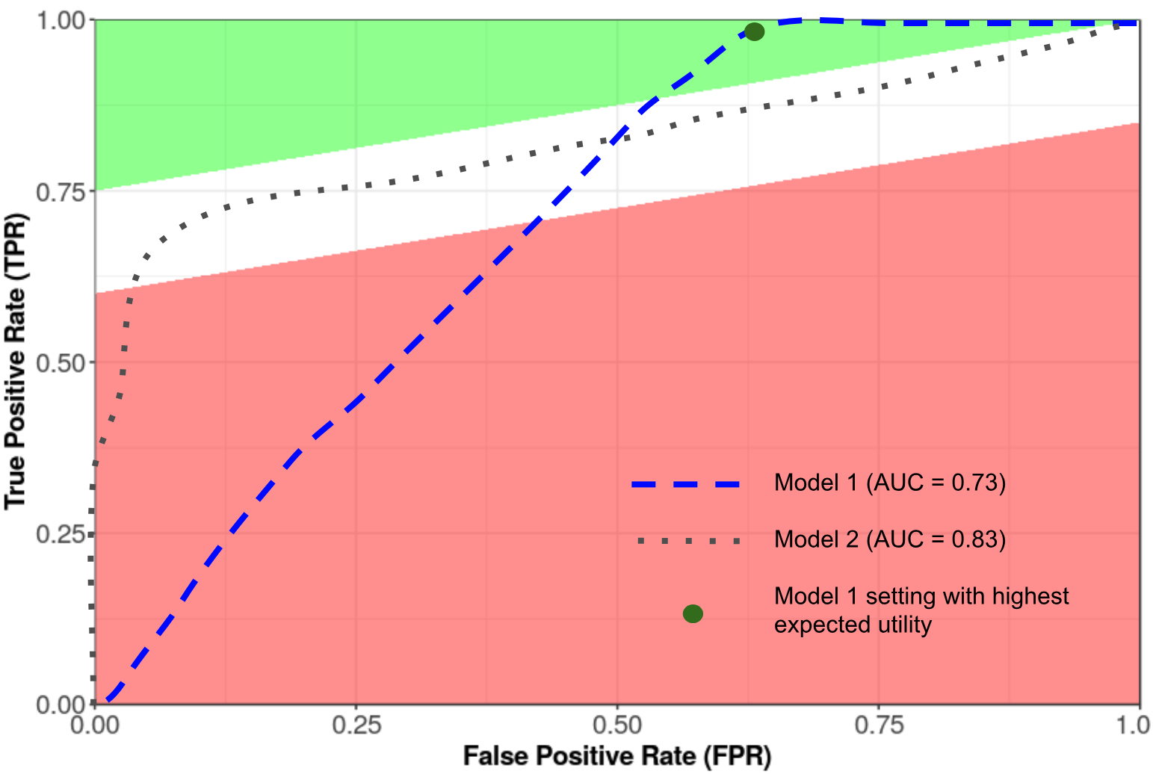
Selecting model for maximal utility
Capacity constraints put lower bound on intervention threshold
Model with higher overall AUC might perform worse in the feasible region!
David Scheinker, Nigam Shah working paper
Notes:
Utility can be calculated using the 2-by-2 table shown earlier, for anywhere in the ROC space
Utility tends to increase as you get closer to a perfect prediction model (upper right corner of ROC space),
Often, net utility of testing will be negative if the prediction model is not good enough
When comparing models, its not necessarily true that point of maximum utility is on the model with the higher overall AUC

Slide 18
Maximizing utility: CKD prediction
Capacity limit
Capacity constrained: Can only intervene in 5% riskiest patients due to limited spots in clinic
If increasing capacity is an option later, utility calculation would inform how many spots to open
Utility-maximizing threshold

Slide 19





CKD prediction implementation
Day 1
(admit)
SCr: 0.4 mg/dL
Day 2
SCr: 0.7 mg/dL
Day 3
SCr: 0.9 mg/dL
Day 4
SCr: 0.6 mg/dL
Day 5 (discharge)
SCr: 0.5 mg/dL
AKI stage = 0
AKI stage = 1
AKI stage = 2
AKI stage = 1
AKI stage = 0
Begin AKI treatment
End AKI treatment
Without model
AKI resolved by discharge, so no outpatient nephrology visits
With model
Risk score generated and sent to AKI survivor’s clinic
Highest-risk patients contacted and enrolled
Notes:
Epic cognitive layer

Slide 20
Takeaways
Algorithmic breakthroughs in individualized risk prediction have had limited impact on real-world clinical decisions
High predictive performance ≠ real-world utility
Assess potential value
Greater chance of successful implementation
Design for the workflow
Maximize utility
Notes:
Prediction isn’t fundamentally aimed at understanding the disease process but rather at informing individuals and assisting in decision-making.
The ultimate decision that is being informed should guide every step of the process from what you try to predict, what data you use to predict it, how you develop and validate your model, and how it is implemented in practice.

Slide 21
Agenda
Improving risk prediction through a decision science lense
Improving decision analyses with ML
Tailoring policies to manage iron deficiency in blood donors
Targeting overdose prevention for prescription opioid patients
Other research plans

Slide 22

Why does heterogeneity matter?
Traditional decision-analytic models focus on average outcomes
Increased interest in distributional outcomes across heterogeneous populations
Enable targeted intervention
Inform equity-related impact
Can also improve estimation of aggregate outcomes!
Source: pmlive.com

Slide 23
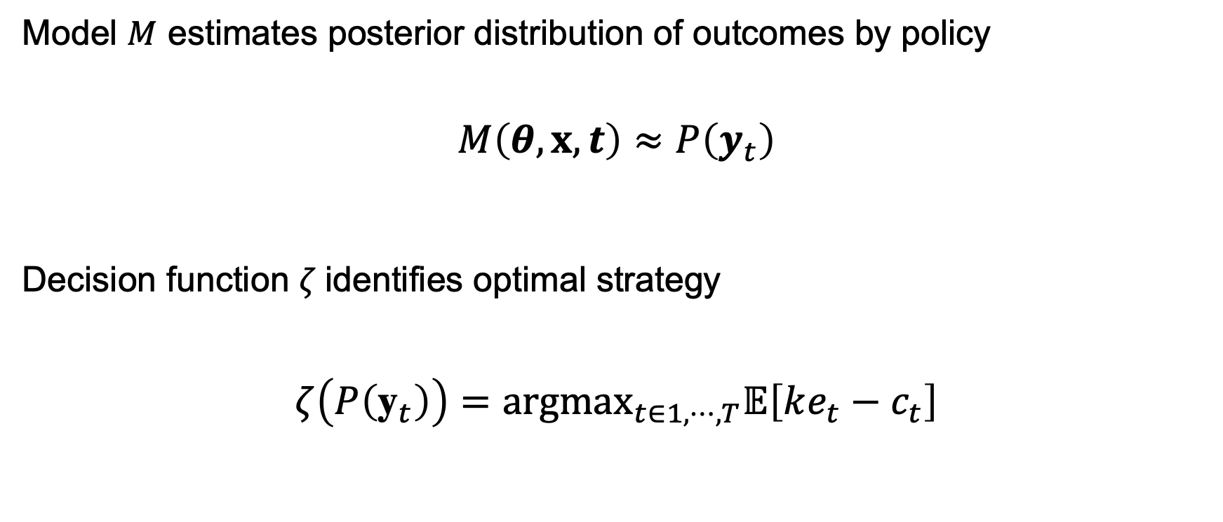
Traditional decision analysis setting
Model $M$ estimates posterior distribution of outcomes by policy
$$M\left(θ,x,t\right)≈P\left(y_{t}\right)$$
Decision function $ζ$identifies optimal strategy
$$ζ\left(P\left({\text{y}}_{t}\right)\right)={argmax}_{t∈1,⋯,T}𝔼\left[ke_{t}−c_{t}\right]$$
Parameters
Policies
Data (sometimes)
Outcomes by policy (multivariate)
Effectiveness
Cost
Maximize population net monetary benefit
Willingness to pay

Slide 24
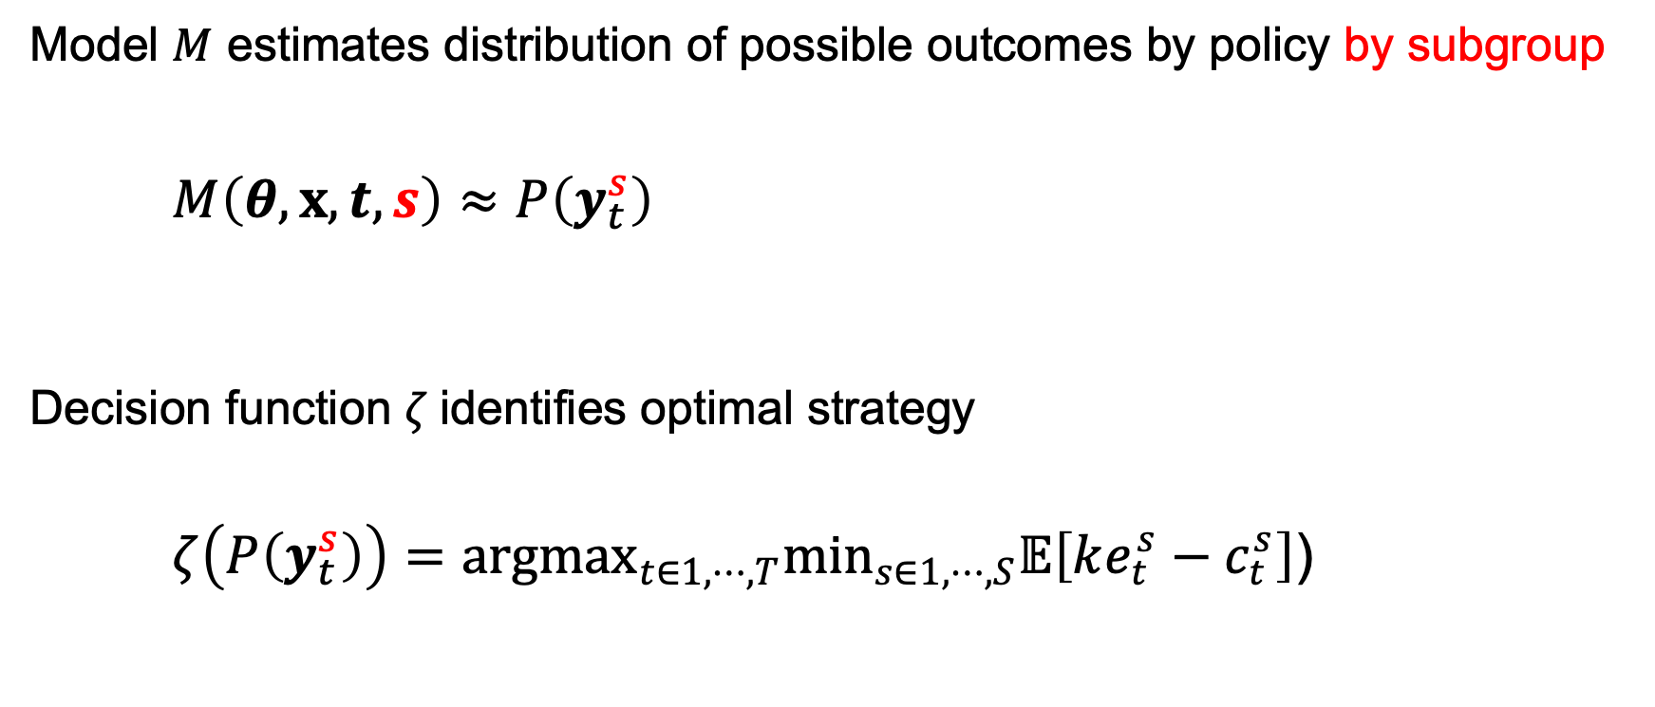
Decision analysis with subgroups
Model $M$ estimates distribution of possible outcomes by policy by subgroup
$$M\left(θ,x,t, s\right)≈P\left(y_{t}^{s}\right)$$
Decision function $ζ$identifies optimal strategy
$$ζ\left(P\left(y_{t}^{s}\right)\right)={argmax}_{t∈1,⋯,T}\min_{s∈1,⋯,S}𝔼\left[ke_{t}^{s}−c_{t}^{s}\right]\text{)}$$
Parameters
Policies
Still hard ☹️
State space explosion
Parameter estimation challenges
Data (sometimes)
Sub-groups
Outcomes by policy by subgroup
Substantial progress 🙂
Maximize net monetary benefit in worse-off subgroup

Slide 25
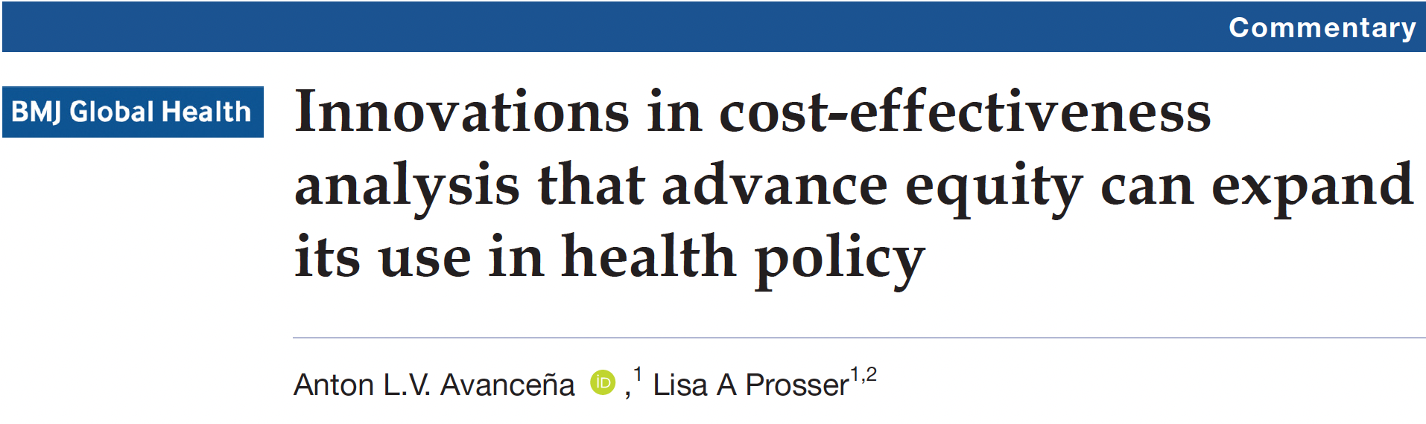
Equity-informative decision analytic frameworks
Distributional cost-effectiveness
Extended cost-effectiveness
Multi-criterion decision analysis
Ex poste equity weighting
Alternatives to quality-adjusted life year
Equal value of life years gained
Health years in total
⚠️ Presuppose subgroup heterogeneity in outcomes accurately estimated ⚠️

Slide 26
D³Mod: Data-driven decision modeling lab
Data-driven methods
Machine learning
Bayesian
statistics
Mathematical modeling
Simulation
Optimization
D³Mod
Decision analysis
Inform effective, equitable, efficient health policy
Application areas
Blood donor management
Opioid harms reduction
Cancer screening & treatment
Pandemic surveillance
Safe blood transfusion

Slide 27


Improving decision analyses with ML
Tailoring policies to manage iron deficiency in blood donors
Targeting overdose prevention for prescription opioid patients
Other research plans
Supported by

Slide 28


Blood donation and iron deficiency
Two safety measures in U.S.
But iron depletion for blood donors remains a problem
Minimum hemoglobin
Minimum inter-donation interval
12.5 g/dL for women
13.5 g/dL for men
56 days for single red cell unit
84 days for double red cells
5-10%
Donation attempts result in hemoglobin deferrals
20-40%
Completed donations are from donors with low or absent iron stores
Notes:
The US uses a minimum hemoglobin to qualify donors and requires an 8-week interval between whole blood donations. Despite these safeguards, many donations are taken from donors with already low or absent iron stores. In addition, low hemoglobin deferrals represent a waste of resources and decrease donors’ likelihood of returning.

Slide 29


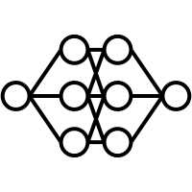
Interventions for iron-related adverse outcomes
Intervention | Benefits | Drawbacks
Longer minimum interval universal or sex-based | More time for iron recovery | Reduces donation frequency
Supplemental iron Dispense pills or vouchers | Hastens iron recovery No change to donation frequency | Cost Side effects (liability?)
Ferritin testing If low: longer interval or supplemental iron | Targets the iron deficient Smaller threat to supply | No point-of-care test Cost Compliance
Intervention | Benefits | Drawbacks
Personalized minimum interval Tailor interval to donors’ estimated risk | Targets high-risk donors Balances risk vs. supply | Complex Untested
Notes:
Several interventions have been explored for reducing deferals and preventing donations from low- and absent-iron donors.
Most countries have longer minimum donation intervals, with some require a longer interval for women as compared to men. This allows more time for iron recovery but could jeopardize ability to meet demand.
Some blood centers provide or recommend daily supplemental iron to repeat donors. Supplemental iron hastens iron recovery, and an advantage is that this intervention does not reduce donation frequency. Potential drawbacks include costs and a small risk of side effects such as gastrointestinal distress.
Some blood centers have began testing for ferritin, a more stable and reliable measure of iron status. However, ferritin testing cannot be done at ‘point-of-care’, so iron-deficient donors are only informed of their status after the additional insult of further iron loss from blood donation has occurred. Blood centers who test for ferritin typically recommend a longer donation interval or supplemental iron to donors who have low or absent iron stores.
Click
In this project, I analyzed a new potential strategy: tailoring the donation interval to each donor’s risk of adverse outcomes as estimated by a machine learning model. This approach only assigns longer intervals to donors with higher risk in order to balance protecting donors with maintaining a sufficient supply. Potential drawbacks are that it’s a more complex policy and has not been tested.

Slide 30
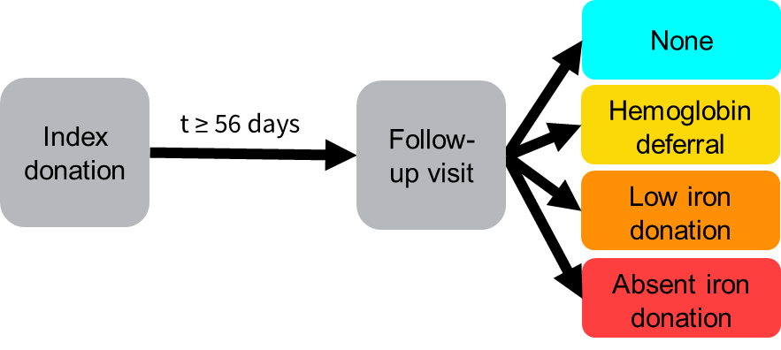
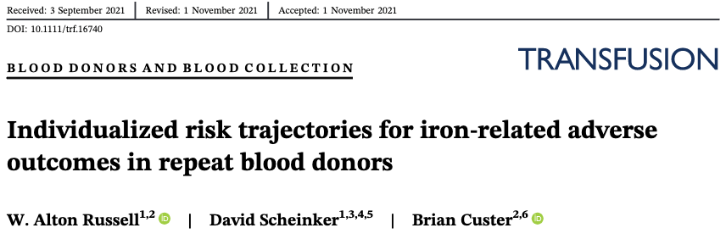
Predicting adverse outcomes
No adverse outcome

Slide 31
Data for risk prediction: RISE dataset
Data from index donation (partial list)
Time to return (days)
Donation
history
Donations last 12 months
Donations last 24 months
Blood volume lost
Days since prior red cell loss
Questionnaire responses
Diet
Height/weight
Iron supplements, multivitamins
Reproductive health indicators
Biomarkers
Hemoglobin
Ferritin*
Soluble transferrin receptor (sTfR)*
Body iron*
*Secondary analysis
Adverse outcome at follow-up
0 No adverse outcome
Hemoglobin deferral
Low iron donation
Absent iron donation
-1 Unknown iron donation
Cable et al. Iron deficiency in blood donors: the REDS-II donor iron status evaluation (RISE) study. Transfusion. 2012;52(4):702-711.
Notes:
We used data from the REDS-II donor iron status evaluation or RISE, which followed more than 2,400 repeat donors over 2 years. Donation history and hemoglobin were recorded for each index donation, and detailed questionnaire responses on diet, smoking, and female reproductive health are available from the baseline visit. We used these data together with the time until the donor returns to predict the outcome of their follow-up visit. We considered 3 adverse events: hemoglobin deferral, and giving blood when iron stores are low or – worse – absent.
Because ferritin and sTfR are not routinely collected in most US blood centers, we developed 2 versions of the model: with and without these extra biomarkers, and compared performance.

Slide 32
Method overview
Discriminative performance
Variable importance
Nested cross validation
Model development set (all labeled)
Uncalibrated top model
RISE Dataset (2425 donors, 2 years)
Pre-process
Probability calibration
First return set
(representative)
Calibrated model
Individual risk trajectories
Tailored IDI algorithm
Policy simulations
Notes:
In preprocessing, I formatted the dataset for prediction and created a model development data, consisting of index donations and the outcomes any follow-up donations. For example, if a donation was followed by a hemoglobin deferral and then a completed donation, both follow-up donations were included in the model development dataset. This dataset was used to select and assess the top model, using a nested cross validation procedure to minimize bias and avoid overfitting. We then assessed the discriminative performance of the top model using a multiclass area under the ROC curve method and assessed feature importance to determine which input parameters were most influential in shaping the models’ estimated risk. We repeated this part of the research twice, once with and without the ferritin and STfR as predictors, to see compare.
Before using the model, we calibrated it to a dataset that included only the outcome of the first follow-up donation for every index donation; this avoided over predicting hemoglobin deferrals which were overrepresented in the model development dataset. We used the calibrated model to develop risk trajectory profiles for every index donation. We then developed a simple decision algorithm that uses these individual risk trajectories were fed into a decision algorithm to identify the tailored minimum donation interval for each index donation, and we performed policy simulation to assess the impact of tailored IDIs.

Slide 33
Prediction model development
Gradient boosted decision trees, random forest, penalized logistic regression, ensembles
Nested cross validation
5-fold CV across 15 tuning sets to select model configuration
3 resamples of 5-fold CV to assess top configuration
Assessed by Area under the ROC curve (AUC)
Multiclass AUC (Hand and Till 2001 average pairwise method)
One vs rest AUC
Two versions:
With and without extra biomarkers (ferritin, soluble transferrin receptor)
Hand & Till. A simple generalisation of the area under the ROC curve for multiple class classification problems. Machine Learning 2001; 45: 171-186
Notes:
I used nested cross validation to select the best-performing configuration of hyperparameters and then achieve an unbiased estimate of the top configuration’s performance. For ensemble models, I took 4-6 top-performing models and averaged their predictions. The metric I used was the average pairwise area under the ROC curve as developed by Hand and Till.

Slide 34
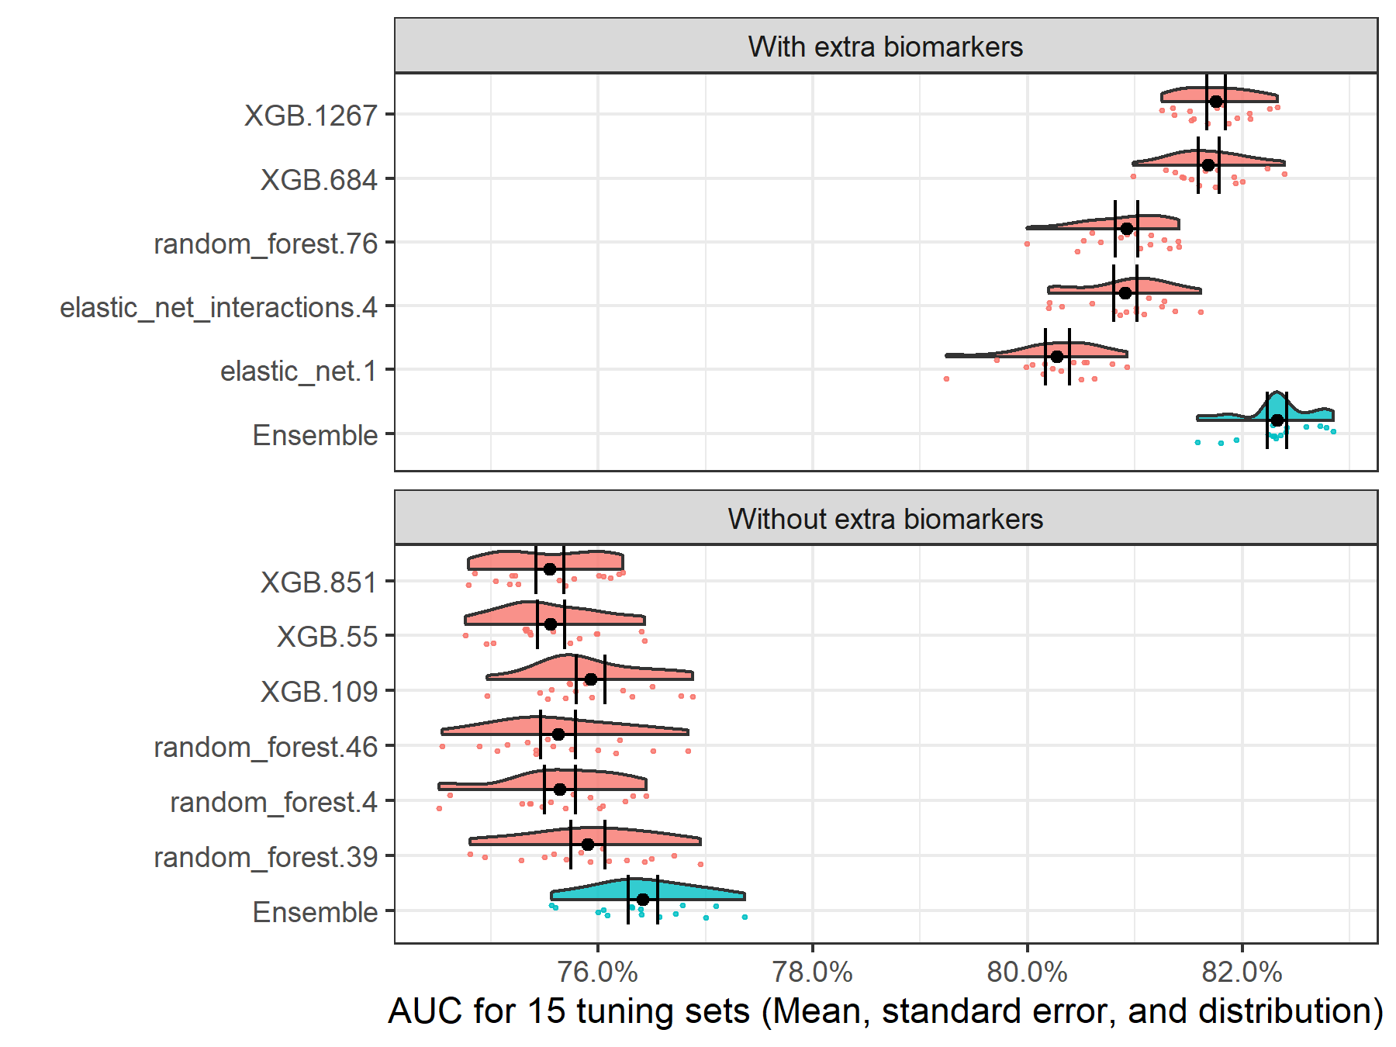
Model selection: Ensemble models
Notes:
Extreme gradient boosted models and random forest tended to perform the best out of the base models. For both versions of the problem, the top overall model was an ensemble of 5-6 base models. Here I’m showing the AUCs of the top ensemble model together with the models contained in the ensemble. The ensemble tended to have a higher AUC and a smaller standard error as compared to the base models.

Slide 35
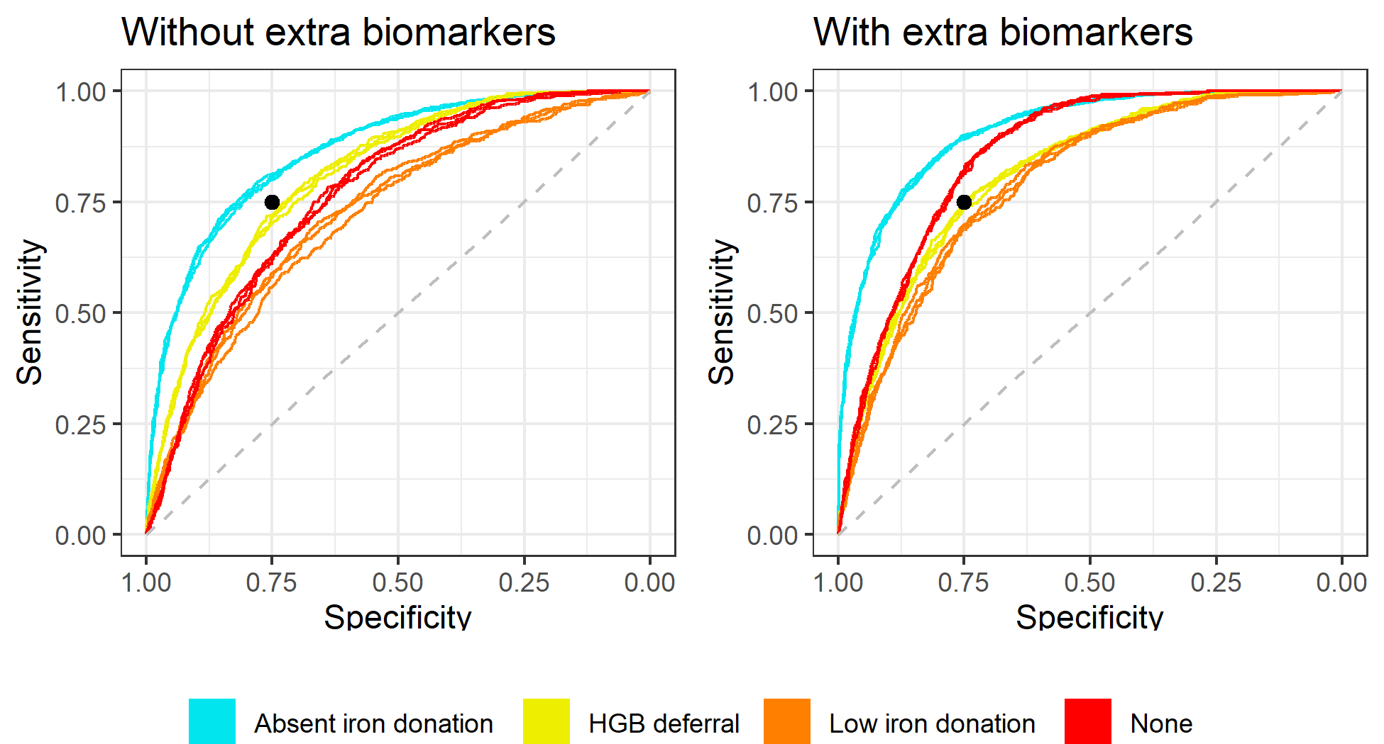
Top model out-of-sample AUC
 | Without extra biomarkers | With extra biomarkers
Overall AUC | 77.5% | 82.8% +5.3
No adverse outcome | 86.5% | 91.1% +4.6
Deferral | 81.1% | 81.6% +0.4
Low iron donation | 72.5% | 79.4% +6.9
Absent iron donation | 76.8% | 85.8% +9.0
One-vs-rest AUC
No adverse outcome
Low iron donation
HGB deferral
Absent iron donation
Notes:
Here I’m showing two ROC plots with the one-vs-rest AUC for each outcome.
Both models were best at distinguishing “no adverse outcomes” from the others, shown here in cyan.
The overall AUC was 78% without extra biomarkers, which increased to 83% when ferritin and soluble transferrin receptor were available.
Improvements from the additional biomarkers were largest for distinguishing low and absent-iron donations from the other outcomes, with an increase of 9% in absent iron donations.
You can see that without the extra biomarkers, the model predicts hemoglobin deferral better than low or absent iron. With the extra biomarkers, the model is now better at predicting absent iron donations.

Slide 36
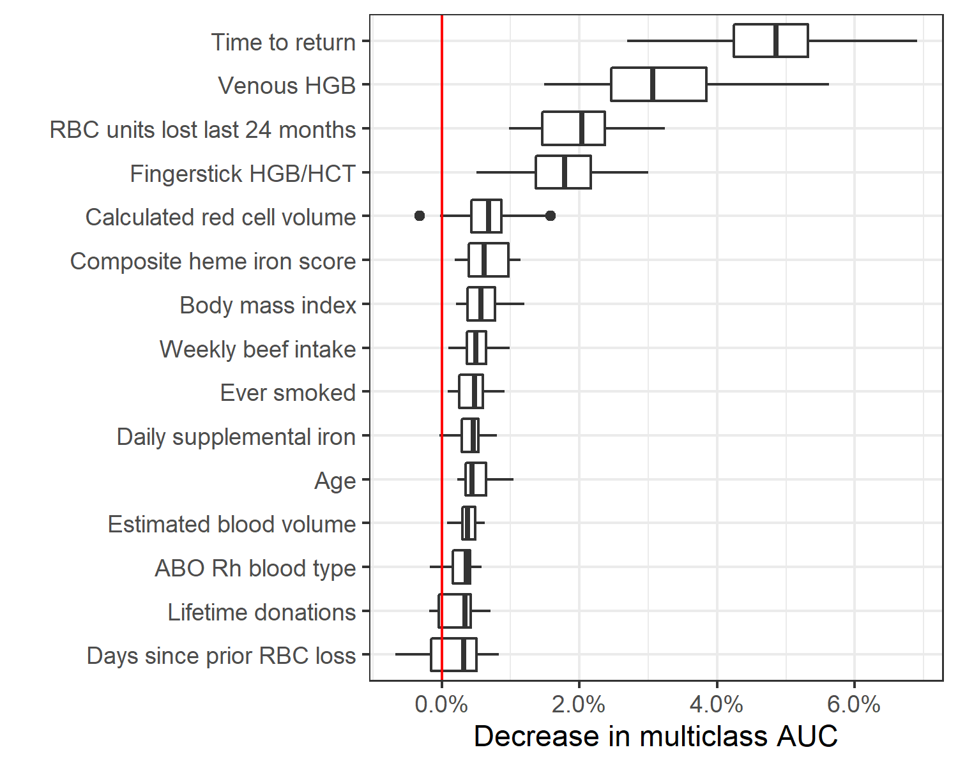
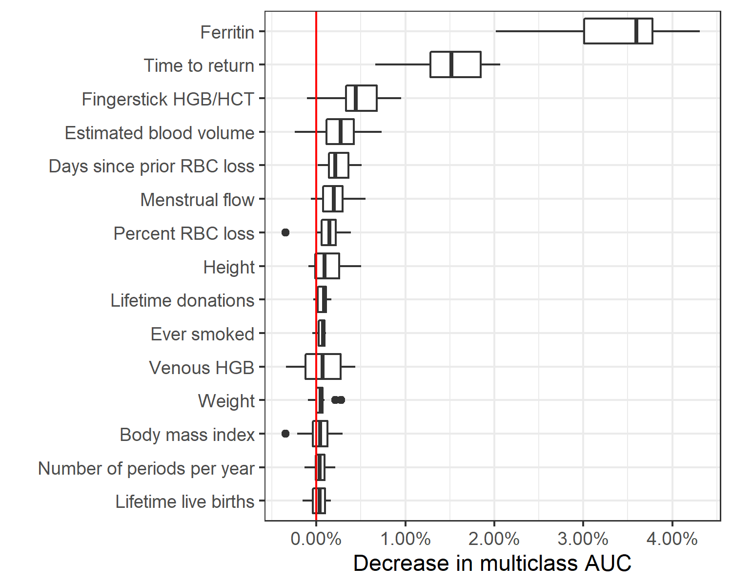
Feature importance
Without extra biomarkers
With extra biomarkers
Notes:
I analyzed feature importance using a permutation method: Across the 15 assessment cross-validation folds, I trained the model and then predicted on the test set. Then, I randomly shuffled each feature one at a time and analyzed the extent to which the multiclass AUC decreased.
Here I’m showing the 15 variables with the largest median decrease in multiclass AUC across the cross-validation folds..

Slide 37
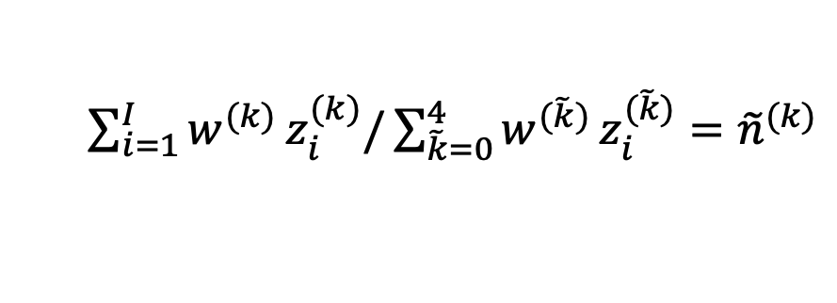
Probability calibration
Estimate distribution in first return assuming ferritin measures missing at random
Predict on first return set
Apply weighted normalization to scores so expectation of predictions matches the estimated distribution
$\sum_{i=1}^{I}{w^{(k)}}z_{i}^{(k)}/\sum_{\tilde{k}=0}^{4}{w^{(\tilde{k})}}z_{i}^{(\tilde{k})}={\tilde{n}}^{(k)}$
Dataset | None | HGB defer | Low | Absent | Unknown
Model development set | 1163 (39%) | 732 (25%) | 565 (19%) | 506 (17%) | 0
First return set | 1026 (29%) | 541 (15%) | 495 (13%) | 380 (10%) | 1243 (34%)
Target distribution | 3344 (46%) | 636 (9%) | 1882 (26%) | 1417 (19%)
Weight no extra biomarkers | 1.04 | 0.73 | 1.22 | 1.19
Weight extra biomarkers | 1.05 | 0.74 | 1.13 | 1.20
Notes:
Recall that the distribution of outcomes is different for the model development dataset and the first return dataset. The model development has more labeled donations, while the first return dataset includes 1200 donations for which ferritin was not measured at follow-up so we don’t know if it resulted in a low or absent donation. To address this, I developed calibration weights.
Click
The first step is identifying a target distribution. By assuming ferritin scores are missing at random, I redistributed the unknown outcome donations proportionally to derive a distribution target.
Next, I generated raw, uncalibrated predictions for the entire first return dataset, and I solved the system of equations shown here to calculate weights that would ensure that the expectation of the distribution of the outcomes would match the target distribution.
Click
Here are the weights we use in calibration. As expected, the calibration steps down-weights the predicted risk for hemoglobin deferral and increases the predictive risk for the other three outcomes. By applying these weights to the risk scores, we’re able to generate risk trajectories for each donor.

Slide 38
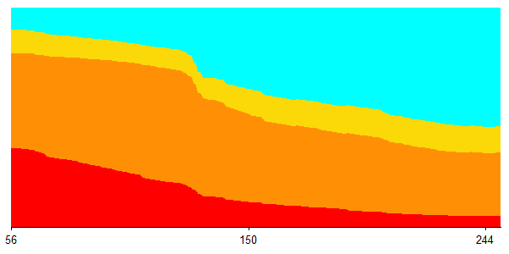
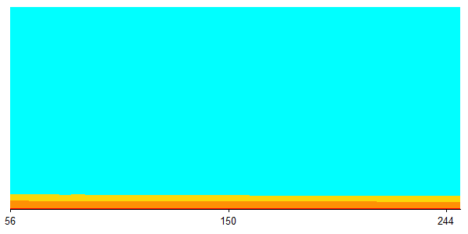
Individual donor trajectories
Donor 1
Probability of outcome
Days until next attempt
No adverse event
Hemoglobin deferral
Probability of outcome
Donor 2
Low iron donation
Absent iron donation
Days until next attempt
Notes:
I then used the calibrated model to produce risk profiles for every index donation in the first return dataset. Here I’m showing the risk trajectories for two example donors.

Slide 39
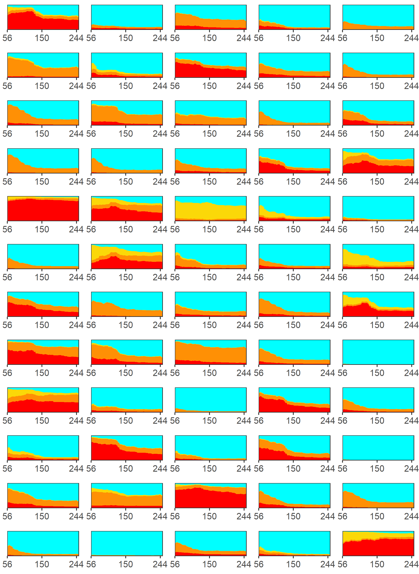
Individual trajectories highly variable
No adverse event
Hemoglobin deferral
Low iron donation
Absent iron donation
Notes:
Here I’m showing 25 individual donor’s risk trajectory. To highlight how much variability there is.

Slide 40
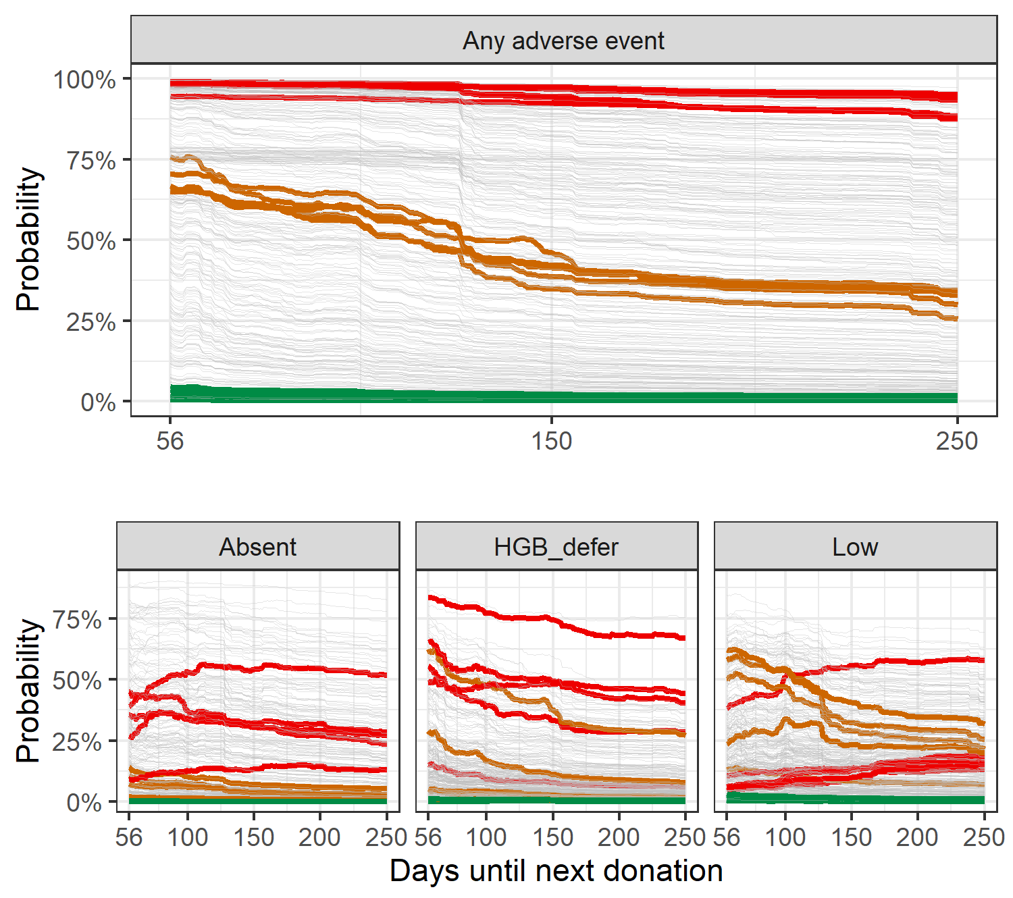
Classifying trajectories
Fast recovery: low risk 56 days after index donation
Slow recovery: Risk high initially but drops
Chronic high risk: estimated risk high even 250 days later

Slide 41
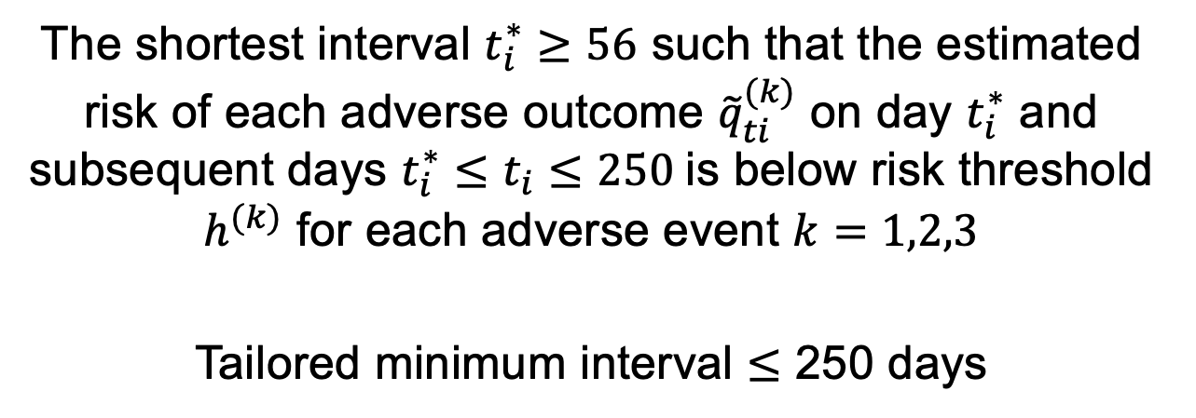
Decision rule for tailored inter-donation interval
$t_{i}^{∗}=min(t_{i}≥56)$ such that ${\tilde{q}}_{ti}^{(k)}≤h^{(k)}$ for all $t_{i}^{∗}≤t_{i}≤250$ for $k=1,2,3$
The shortest interval $t_{i}^{∗}≥56$ such that the estimated risk of each adverse outcome ${\tilde{q}}_{ti}^{(k)}$ on day $t_{i}^{∗}$ and subsequent days $t_{i}^{∗}≤t_{i}≤250$is below risk threshold $h^{(k)}$ for each adverse event $k=1,2,3$
Tailored minimum interval $≤$ 250 days

Slide 42
Policy simulation
Simulated
Status quo (56 days for women and men)
Canadian IDIs (84 days for women; 56 days for men)
Australian IDIs (84 days for women and men)
UK IDIs (112 days for women; 84 days for men)
Personalized IDIs
Estimated
Donations collected per 100 donors per year
Adverse outcomes per collected donation
Caveat! Simple return assumptions and specific to RISE donors
Notes:
When looking at these simulation results, it’s important to bear in mind that the RISE cohort differs from a typical donor population in important respects. Study participants committed to donating more frequently, there may be a higher proportion of female donors, and we made a strong assumption that ferritin measures were missing at random. For these reasons, the simulation is more useful for assessing the relative performance of different policies in this simulated population rather than the absolute performance in a general donor population.

Slide 43
Policy simulation % change from status quo
Policy | Collections | HGB deferral | Low iron donation | Absent iron donation
Can 84W-56M | -7.6% | -18.8% | -1.0% | -9.3%
Tailored 0.2H-0.5L-0.4A | -7.1% | -32.3% | 0.7% | -16.5%
Aus 84W-84M | -17.9% | -24.6% | -10.8% | -12.4%
Tailored 0.2H-0.4L-0.2A | -17.0% | -46.6% | -2.6% | -37.4%
UK 112W-84M | -25.4% | -39.2% | -15.5% | -17.3%
Tailored 0.3H-0.6L-0.1A | -25.0% | -58.6% | -4.0% | -53.4%
Universal policies: Country, interval for Women, interval for Men (in days)
Tailored policies: risk threshold for Hemoglobin deferral, Low, and Absent iron donations
Tailored interval policies can have smaller loss of collections and a larger reduction of adverse outcomes compared to longer universal intervals
Low iron donations can increase due to “converted” deferrals and absent iron donations

Slide 44




In progress: External validation in operational datasets
External validation: Predict hemoglobin and ferritin in operational data
Conformal predictive system: estimate probability donor in normal range at return
Supported by
Vitalant
South African National Blood Service
Sanquin
Chen-Yang Su, MSc
PhD student
Quantitative Life Sciences

Slide 45
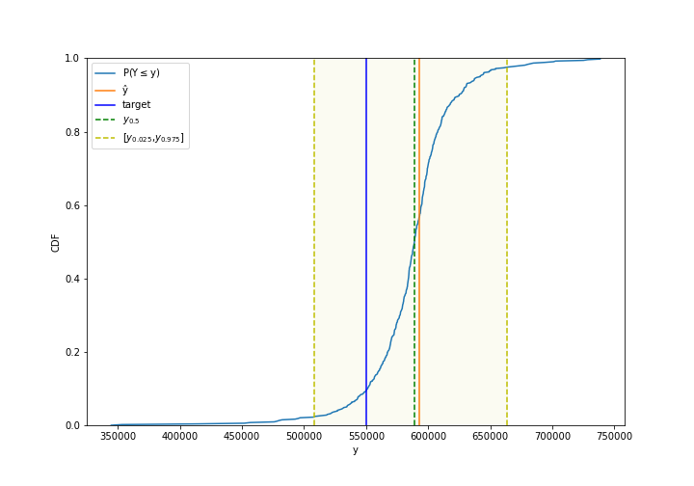
Conformal predictive systems
Using a calibration set, estimate a distribution for the outcome
Inputs:
Y_hat: ML predicted outcome
Y: actual outcome
Sigma: difficulty estimate
assign more uncertain distributions to more difficult examples
Could enable ML models to be used in decision analysis with probabilistic sensitivity analysis!
https://github.com/henrikbostrom/crepes

Slide 46
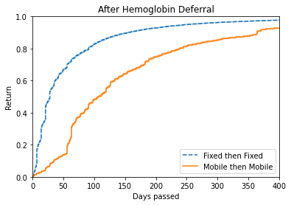

In progress: Donor return microsimulation
Donors assigned longer interval may not return right away
Donors at mobile sites different from donors at fixed collection sites
Goal: analyze donor return behavior and use to simulate policy changes
Huzbah Jagirdar, BA
MSc student
Epidemiology

Slide 47
Planned data-driven simulation approach
Discrete event simulation model
Covariates for return model
Model predicting outcome at return visit
Covariates from a visit: age, sex, donation history, mobile/fixed site, season, etc.
Simulated time to return
Simulated outcome at return visit
Time to return model
Evaluate changes to hemoglobin threshold, inter-donation interval, deferral policies, etc.
Notes:
When looking at these simulation results, it’s important to bear in mind that the RISE cohort differs from a typical donor population in important respects. Study participants committed to donating more frequently, there may be a higher proportion of female donors, and we made a strong assumption that ferritin measures were missing at random. For these reasons, the simulation is more useful for assessing the relative performance of different policies in this simulated population rather than the absolute performance in a general donor population.

Slide 48
Take-aways
Targeted management of iron deficiency risk in repeat blood donors informed by combining
Machine learning models that predict time to recovery and trajectory of adverse outcomes
Optimization-based decision rule that assigns return time
Simulation model that estimates operational and health impacts

Slide 49

Agenda
Tailoring policies to manage iron deficiency in blood donors
Targeting overdose prevention for prescription opioid patients
Other research plans
Supported by

Slide 50
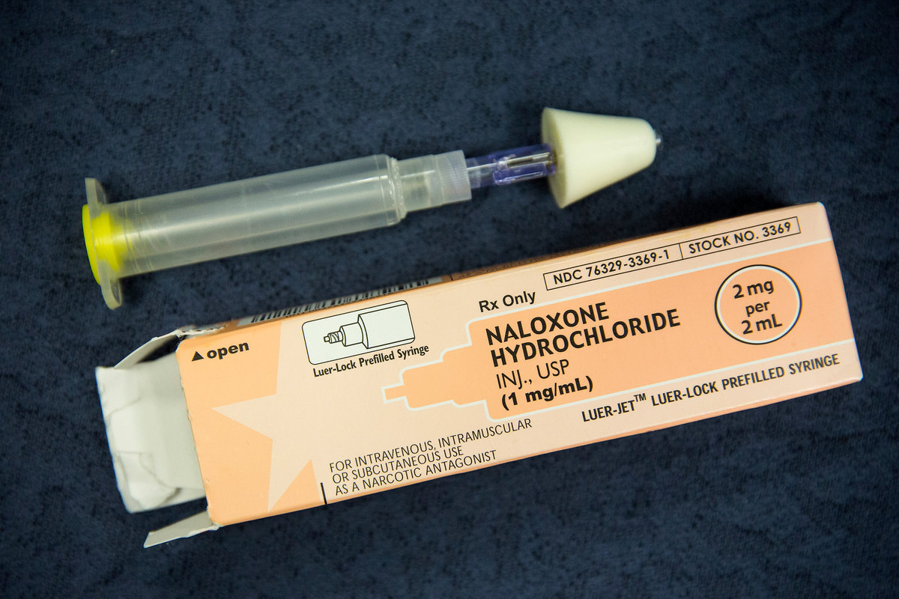
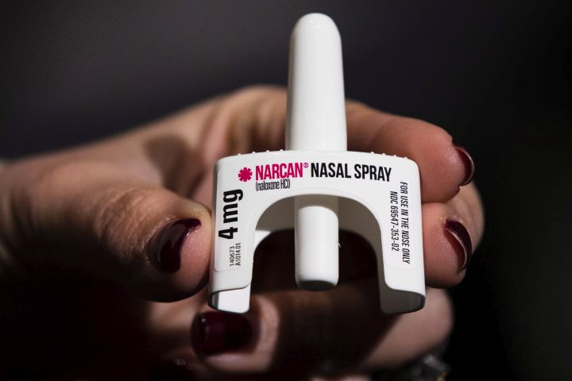
Naloxone reverses overdose
Take-home naloxone very effective for reversing witnessed opioid overdose
Estimated to be cost-saving for people using illicit opioids
Co-prescribing with prescription opioids recommended in several US states with variable criteria
Is dispensing with prescription opioid patients effective and efficient?
ANDREW BURTON/GETTY IMAGES
THE CANADIAN PRESS/AP-Matt Rourke

Slide 51
Longitudinal patient-level data (IQVIA)
Prescribing data: all dispensed drugs for random sample of patients dispensed opioid analgesics Oct. 2018 – Sept. 2021
Construct opioid episodes, identify “risk indicator” drugs
Diagnosis data: all diagnoses for linked patients
Identify diagnosed overdoses, identify “risk indicator” conditions
Demographic data: age, sex, race
Strength: large, representative dataset
Limitation: no data on death, including fatal overdoses

Slide 52
Method overview
Construct opioid episodes
Select cohort
Classify risk indicators
Predict diagnosed overdoses
Impute undiagnosed overdoses
Analyze overdose rates
Simulate outcomes with naloxone
Analyze distributional impacts
Cohort analysis
Policy simulation

Slide 53
Construct opioid episodes
Series of opioid prescriptions with no gaps of >30 days in supply
Account for overlapping days supplied
W days
Medication carryover
t
W days
Episode duration

Slide 54
Construct cohort
47,911,161 individuals;
337,273,622 Rx claims
Complete info on age, gender, race/ethnicity
18,194,145 individuals;
52,749,783 opioid episodes
Remove Days Supply =999/0/NA; n=4,863
Started between 1 Oct 2018 and 30 Sep 2019
4,393,655 individuals;
5,862,475 opioid episodes
47,910,093 individuals;
337,268,759 Rx claims
3,990,941 individuals;
5,368,784 opioid episodes
Remove duplicates; n=375,775 (0.11%)
Had at least one Dx record
47,910,093 individuals;
336,892,984 Rx claims
3,990,941 individuals / opioid episodes
Use first episode for each person
119,494,139 opioid episodes
3,983,298 individuals / opioid episodes
Not dispensed naloxone

Slide 55
Operationalize risk indicators
2yr before episode start
Episode start
Diagnosis indicating persistent risk
Drug indicating persistent risk
2yr after episode start
Drug with interaction risk
Within 30 days of episode start
Outcome: Opioid Overdose

Slide 56
Identify risk indicators
Prescription risk indicator groups
Persistent risk | Antipsychotic
 | Stimulant
 | Anti-depressant
 | Anxiolytic
 | Medication for opioid use disorder
 | Mood stabilizer
 | Clonidine
 | Antiseizure
Interaction risk | Benzodiazepine
 | Barbituates
 | Pregabalin
 | Muscle relaxant
 | Gabapentin
 | Z-drug
 | Prazosin
Opioid dose | High dose (>60 DMME)
Diagnosis risk indicator groups
Mental health
Nicotine dependence
Substance use
Severe mental health
Dementia
Overdose, poisoning, self-harm
Opioid overdose

Slide 57
Analyze overdose rates
Preliminary results

Slide 58
Imputing fatal overdoses
Calibration targets derived from literature
Total number of fatal OD (whole cohort + certain subgroups)
Ratio of fatal : non-fatal diagnosed overdose
Predictive model estimate distribution across group
Assumption: Risk factors for unobserved fatal OD and diagnosed OD are same
Random forest model
Use age, sex, race, risk indicators, episode duration, etc.

Slide 59
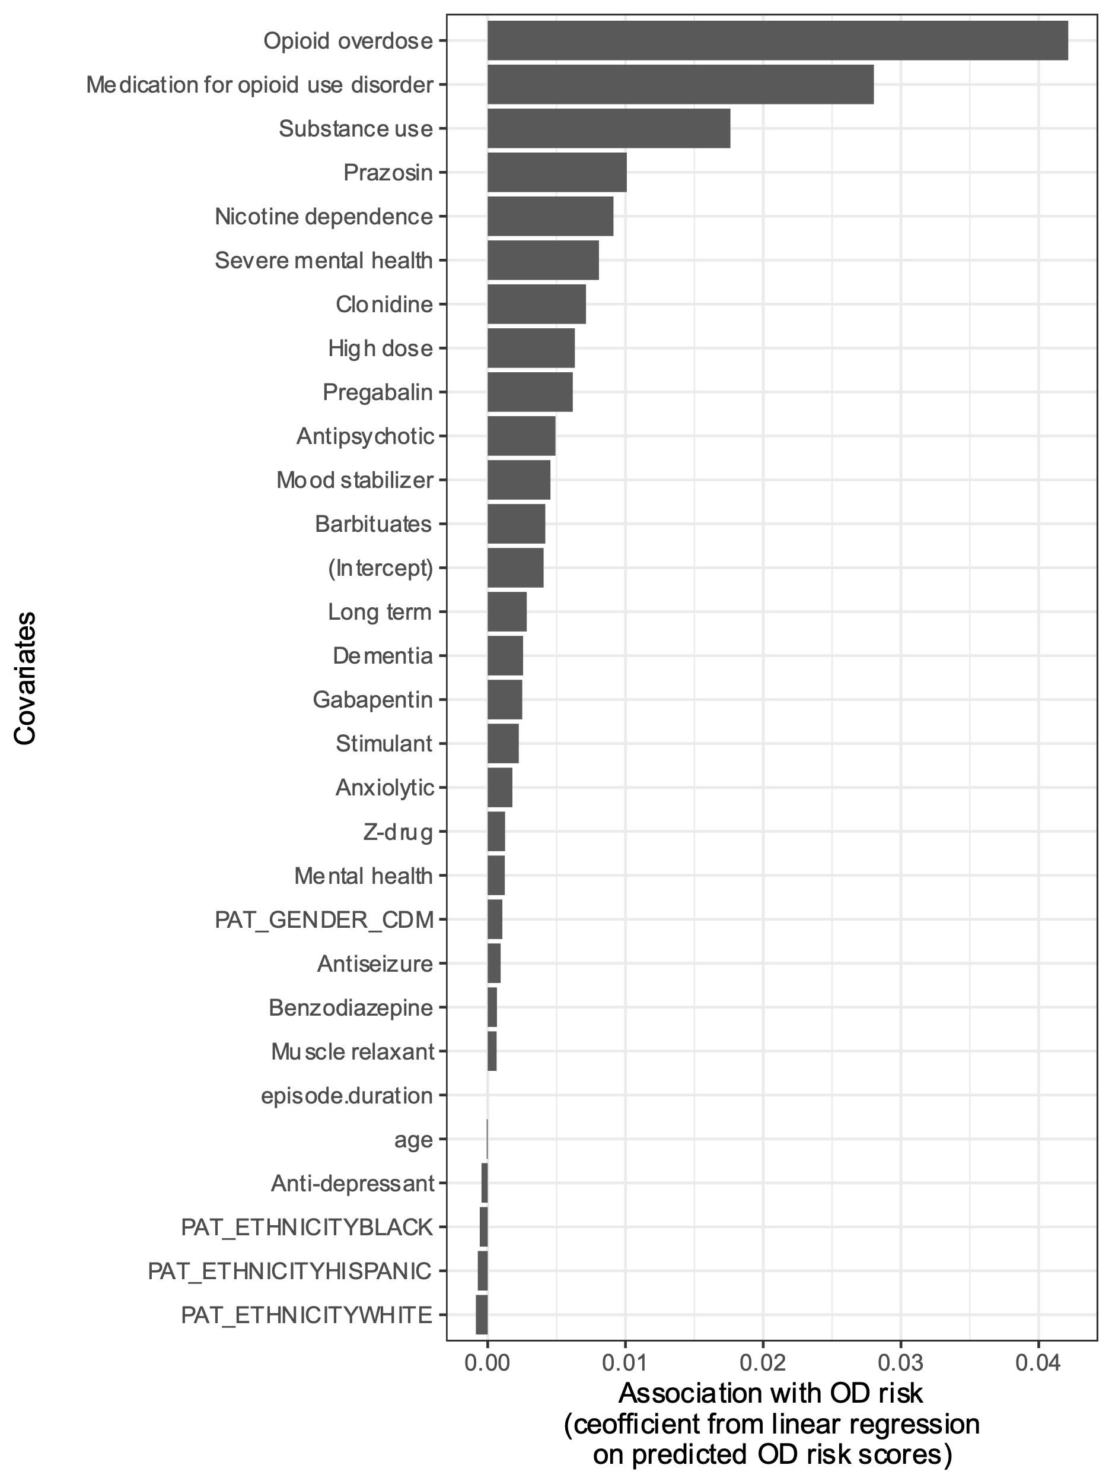
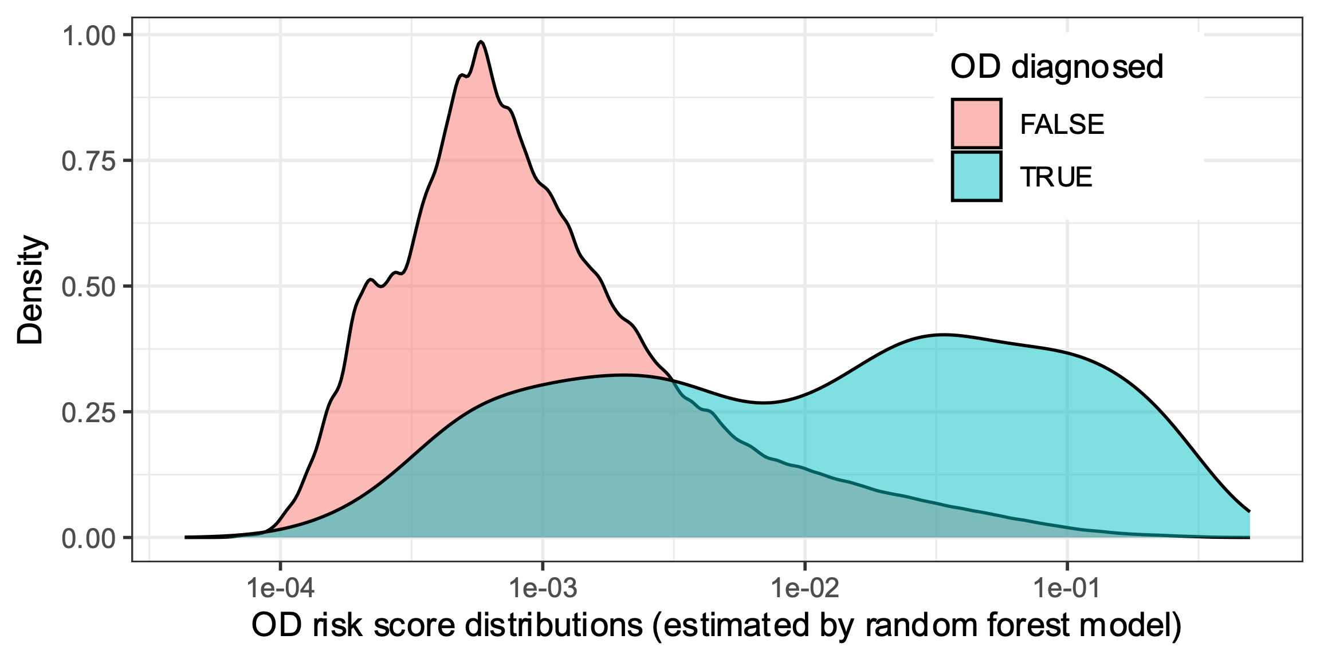
Predicting diagnosed overdose
Area under the ROC curve of 82%

Slide 60
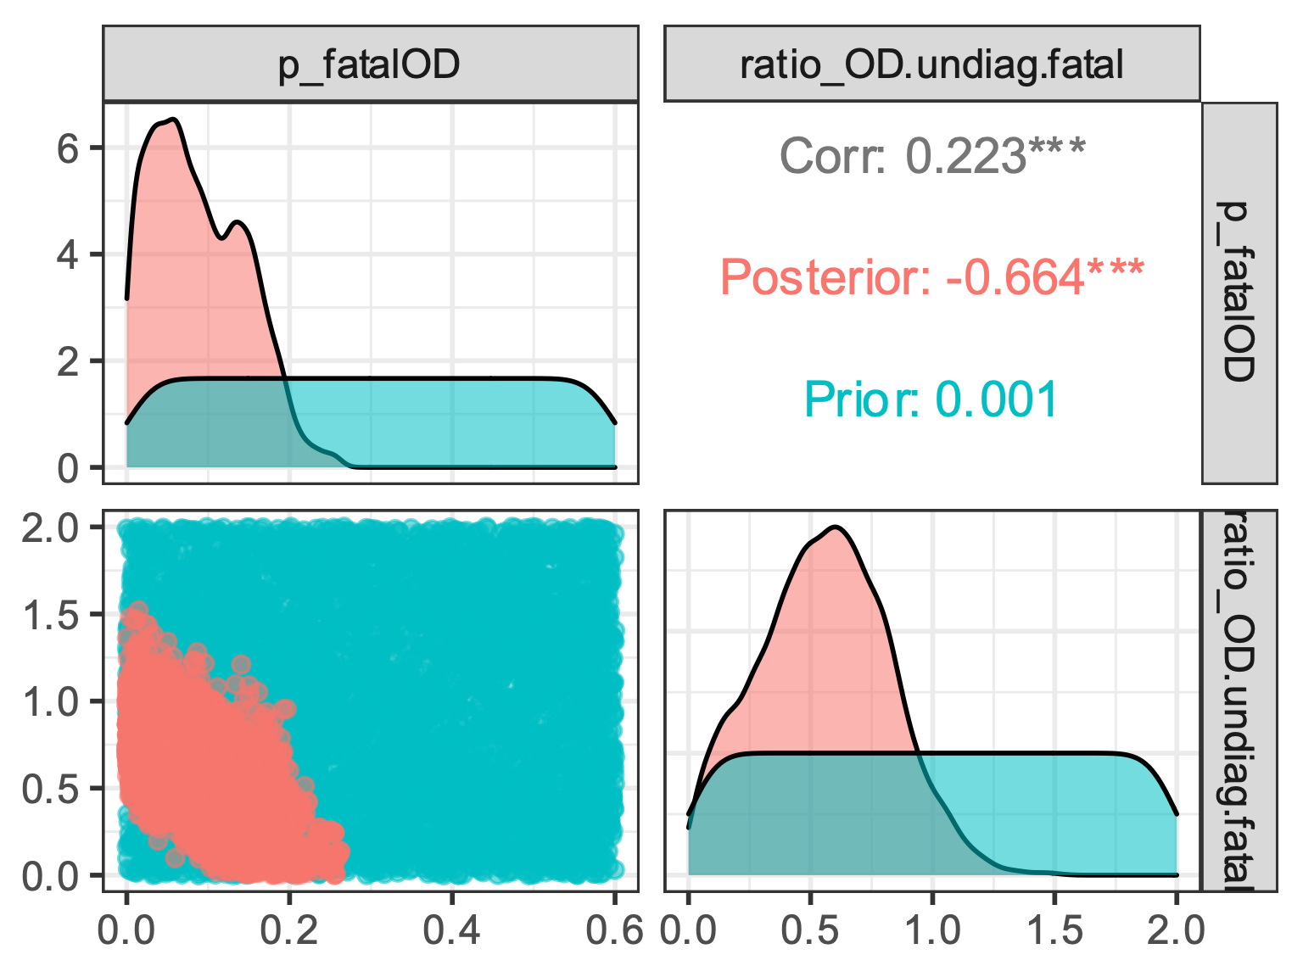
Impute undiagnosed overdoses
Used Bayesian model calibration with incremental mixture importance sampling
Generated 5,000 sets of parameters for fatal overdose risk
P fatal OD
Fatal:nonfatal OD
P fatal OD
Fatal:nonfatal OD

Slide 61
Policy simulation assumptions
Naloxone can avert fatal overdoses within 2 years
Naloxone used when
Overdose witnessed 40% to 80% probability
Naloxone available 30% to 50% probability
Bystander uses it 62% to 92% probability
If used
Prevents fatal overdose 80% to 99.9% probability
Patient doesn’t seeks care 0% to 50% probability

Slide 62
Health economic outcomes
Societal perspective (considers impacts on productivity)
Non-fatal overdose
Healthcare costs
Loss of 1 to 5 quality-adjusted life days
Loss of 0.2 to 20 days productivity
Fatal overdose
Loss of remaining expected QALYs (age-based)
Loss of remaining lifetime net productivity

Slide 63
Cost-effectiveness by risk indicator
Preliminary results

Slide 64
Take-aways
Combining methods from epidemiology, machine learning, and decision modeling can help target overdose prevention
Naloxone is likely cost-effective for patients with risk indicators
Particularly indicators of substance use disorder
Uncertainty could be reduced with
Better data on naloxone utilization for patients prescribed opioids
Linked data on fatal overdoses

Slide 65
Agenda
Tailoring policies to manage iron deficiency in blood donors
Targeting overdose prevention for prescription opioid patients
Other research plans

Slide 66
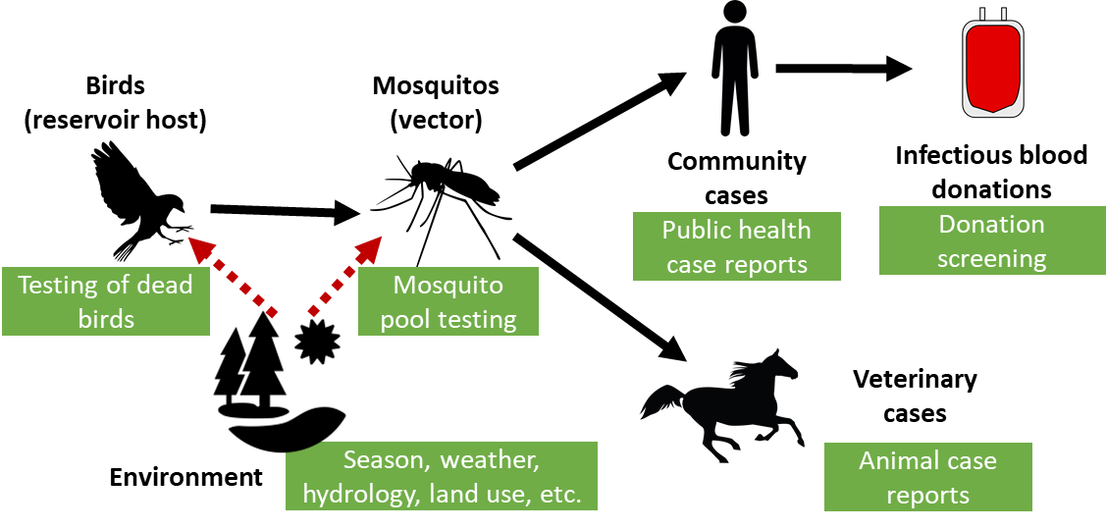
Surveillance, forecasting, & decision model: transfusion-transmitted West Nile virus
Aim: Integrate multimodal surveillance forecasting & decision model to inform when blood collectors screen for West Nile Virus

Slide 67
Evaluating policies to address colonoscopy access in Québec
Colonoscopies used for different patient categories
Screening (~45%): in Québec, usually after positive fecal test
Surveillance (~25%): regular screens for recurrence of cancer or pre-cancer
Symptom assessment (~30%): to identify/rule out gastrointestinal diseases as cause
Wait lists have exploded during COVID-19 and continue to exceed medical recommendations
Aim: use data-driven policy simulation to inform strategies to prioritize colonoscopy access and address wait times

Slide 68
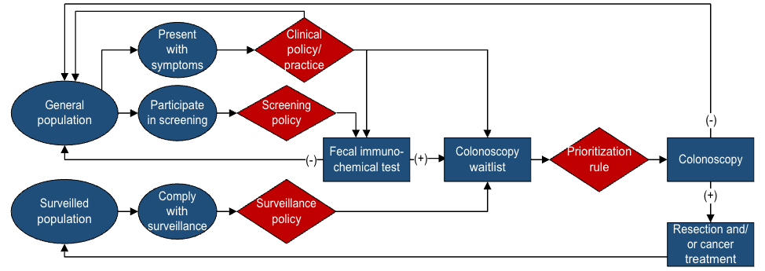
Evaluating policies to address colonoscopy access in Québec
Analyze colonoscopy referral + procedure data
Calibrate discrete event model with heterogeneous patients
Simulate patient prioritization strategies
Integrate OncoSim colorectal cancer model to estimate long-term health-economic impact

Slide 69
Planned data-driven simulation approach
Discrete event simulation model
Covariates for colonoscopy finding prediction model
Model predicting outcome at procedure
Covariates from colonoscopy referral
Simulated time to procedure
Simulated colonoscopy findings
Time to return model
Notes:
When looking at these simulation results, it’s important to bear in mind that the RISE cohort differs from a typical donor population in important respects. Study participants committed to donating more frequently, there may be a higher proportion of female donors, and we made a strong assumption that ferritin measures were missing at random. For these reasons, the simulation is more useful for assessing the relative performance of different policies in this simulated population rather than the absolute performance in a general donor population.

Slide 70
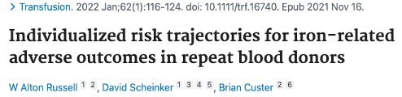
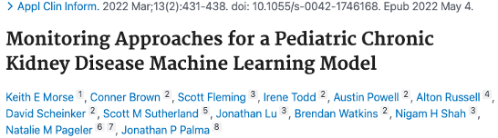
Thank you!
Targeted dispensing of naloxone with prescription opioids: a data-driven cost-effectiveness analysis (working paper)
W Alton Russell, Huiru Dong, Mina Tadrous, Rosalie Pacula, Bruce Shackman, Keith Humphreys, Jake Morgan, Ben Bearnot, Mohammad Jalali

Slide 71
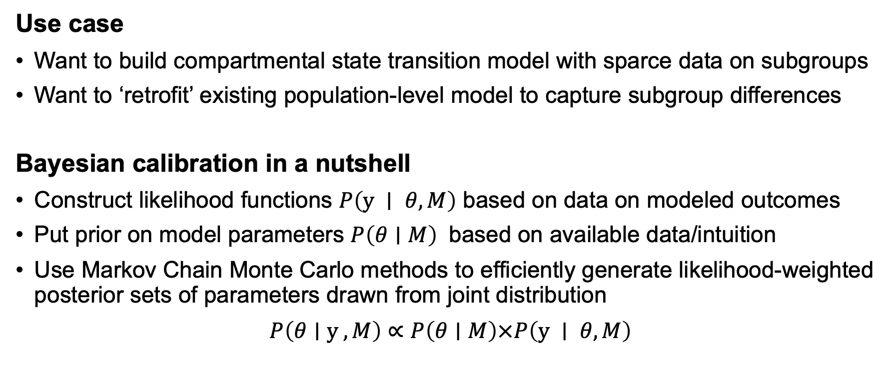
Aim 1: Two-stage Bayesian compositional calibration of cohort models
Use case
Want to build compartmental state transition model with sparce data on subgroups
Want to ‘retrofit’ existing population-level model to capture subgroup differences
Bayesian calibration in a nutshell
Construct likelihood functions $P\left(y ∣ θ,M\right)$ based on data on modeled outcomes
Put prior on model parameters $P\left(θ∣M\right)$ based on available data/intuition
Use Markov Chain Monte Carlo methods to efficiently generate likelihood-weighted posterior sets of parameters drawn from joint distribution
$P\left(θ∣y ,M\right)∝P\left(θ∣M\right)×P\left(y ∣ θ,M\right)$

Slide 72
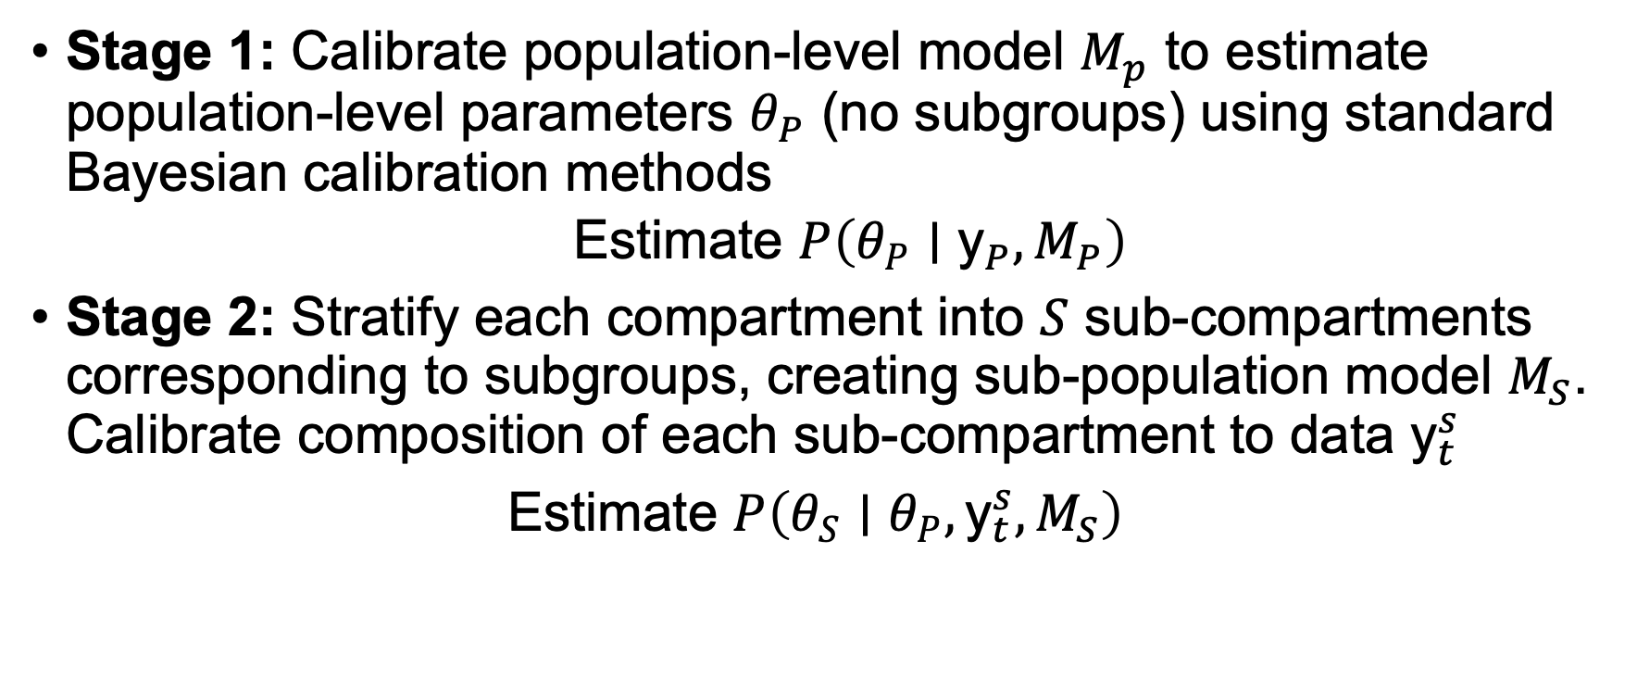
Aim 1: 2-stage compositional calibration Overview
Stage 1: Calibrate population-level model $M_{p}$ to estimate population-level parameters $θ_{P}$ (no subgroups) using standard Bayesian calibration methods
Estimate $P\left(θ_{P}∣{\text{y}}_{P},M_{P}\right)$
Stage 2: Stratify each compartment into $S$ sub-compartments corresponding to subgroups, creating sub-population model $M_{S}$. Calibrate composition of each sub-compartment to data ${\text{y}}_{t}^{s}$
Estimate $P\left(θ_{S}∣θ_{P},{\text{y}}_{t}^{s},M_{S}\right)$

Slide 73
Aim 1: 2-stage compositional calibration To do list
Conceptualize and code preliminary model (Complete!)
Integrate efficiency improvement techniques
Assess performance with different parameter specification
Stationary and non-stationary Dirichlet, “nested betas”
Develop two case studies (simulated data, real data) and compare two-stage and one-stage calibration
Computational complexity
Modeled model likelihood

Slide 74
Aim 2: Bayesian multi-level regression in decision-analytic modeling contexts
Partial pooling from Bayesian multi-level modeling could improve subgroup estimation in decision analytic models
Must contend with common challenges in decision-analytic modeling
Combining data from multiple sources
Individual level data for ‘status quo’ but not other scenarios
Data lacking for some jurisdictions
Extrapolation beyond time horizon of available data

Slide 75
Aim 2: Bayesian multi-level regression Approach
Simulate data with different correlation coefficients between outcomes at individual and interclass level
Create ”benchmark” decision models:
Population level (no subgroup information considered)
Naïve subgroups (estimate best policy by subgroup without pooling)
Develop Bayesian multi-level models for subgroup policies
Mask some data to match common data limitations
Analyze performance under various sample sizes and correlation structures

Slide 76
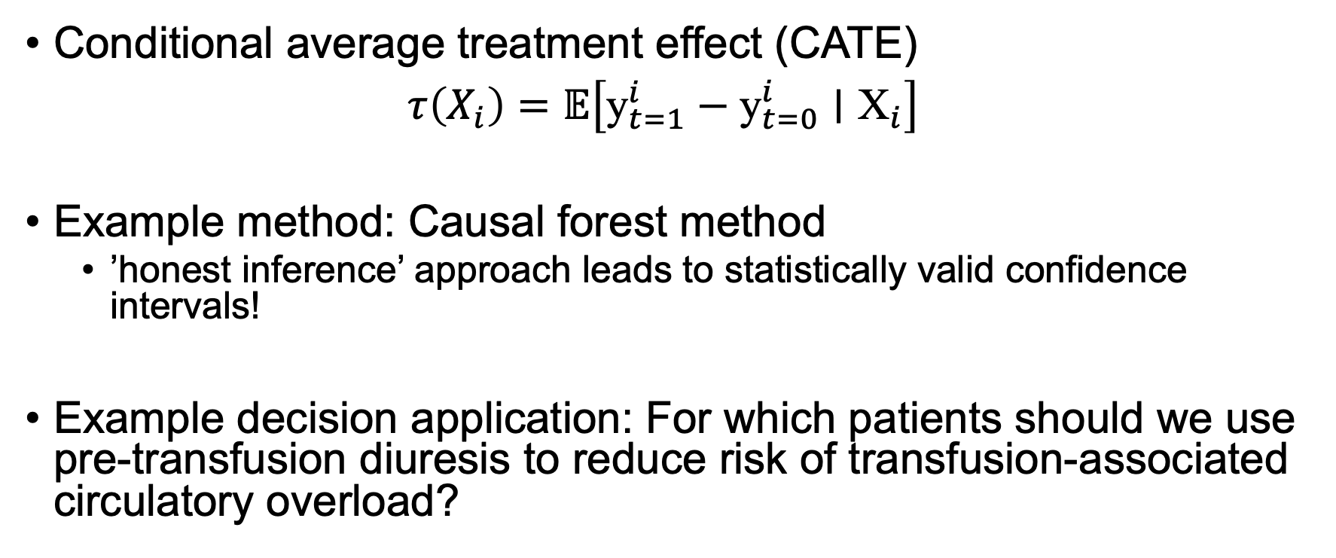
Aim 3: Integrate ML-based heterogeneous treatment effect estimates
Conditional average treatment effect (CATE)
$τ\left(X_{i}\right)=𝔼\left[{\text{y}}_{t=1}^{i}−{\text{y}}_{t=0}^{i}∣{\text{X}}_{i}\right]$
Example method: Causal forest method
’honest inference’ approach leads to statistically valid confidence intervals!
Example decision application: For which patients should we use pre-transfusion diuresis to reduce risk of transfusion-associated circulatory overload?

Slide 77
Aim 3: Causal ML in decision modeling Assess and compare two approaches
CATE first (“plug it in”) approach
Estimate conditional average treatment effect from data
Plug it in to decision model
Estimate optimal decision + uncertainty by subgroup
Model first (“threshold”) approach
Model range of effect sizes
Estimate decision threshold by subgroup
Use data to estimate probability each subgroup’s conditional average treatment effect meets threshold
CATE = conditional average treatment effect

